Slide 1

Exception
Handling
cURL vs File_get_conten
Leo Gabriel Villanueva

Slide 2
WHAT IS cURL
cURL (Client URL Library) allows you to make HTTP requests in PHP scripts, which is useful for interacting with APIs, downloading files, and scraping web data.
cURL is a library used to make HTTP requests in PHP. With cURL, you can interact with other servers and APIs by sending requests and handling responses.

Slide 3
Basic cURL Setup in PHP
Initialize a new session using curl_init().
Set options for the session using curl_setopt().
Execute the session with curl_exec() to make the request.
Close the session using curl_close().

Slide 4
Example: Basic GET Request
$url = "https://jsonplaceholder.typicode.com/posts"; // URL to request
$curl = curl_init($url); // 1. Initialize cURL session
// 2. Set cURL options
curl_setopt($curl, CURLOPT_RETURNTRANSFER, true); // Return the response instead of printing
$response = curl_exec($curl); // 3. Execute the request
if (curl_errno($curl)) { // Check for errors
echo 'Error:' . curl_error($curl);
} else {
  echo $response; // 4. Output response
}
curl_close($curl); // 5. Close cURL session

Slide 5
Setting cURL Options
curl_setopt() allows you to configure various options for a cURL request. Common options include:
CURLOPT_RETURNTRANSFER: Set to true to return the response instead of printing it.
CURLOPT_URL: Sets the URL to request.
CURLOPT_POST: Set to true for POST requests.
CURLOPT_POSTFIELDS: Defines data to be sent in a POST request.
CURLOPT_HTTPHEADER: Sets custom headers.

Slide 6
Making a POST Request
Check curl post request code

Slide 7
Adding Headers
Custom headers are often needed for authentication (like API keys or bearer tokens) or to set content types
curl_setopt($curl, CURLOPT_HTTPHEADER, [
'Content-Type: application/json',
'Authorization: Bearer YOUR_ACCESS_TOKEN'
]);

Slide 8
Handling Errors
To check for errors in cURL, use curl_errno() to detect if an error occurred and curl_error() to retrieve the error message.

Slide 9
Receiving Response Information
To check for errors in cURL, use curl_errno() to detect if an error occurred and curl_error() to retrieve the error message.
$httpCode = curl_getinfo($curl, CURLINFO_HTTP_CODE);

Slide 10
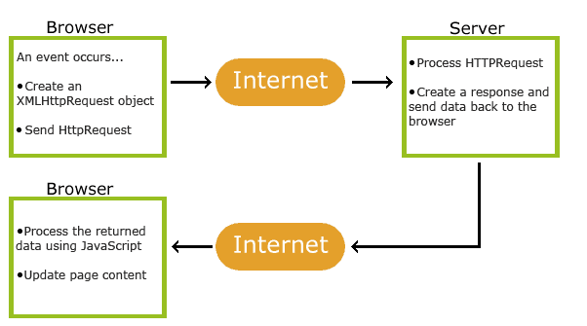
HOW AJAX WORKS

Slide 11
HOW AJAX WORKS
1. An event occurs in a web page (the page is loaded, a button is clicked)
2. An XMLHttpRequest object is created by JavaScript
3. The XMLHttpRequest object sends a request to a web server
4. The server processes the request
5. The server sends a response back to the web page
6. The response is read by JavaScript
7. Proper action (like page update) is performed by JavaScript

Slide 12
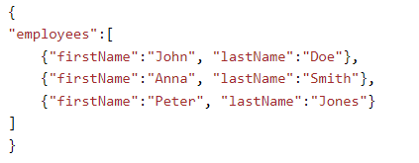
WHAT IS JSON
JSON stands for JavaScript Object Notation
JSON is a lightweight format for storing and transporting data
JSON is often used when data is sent from a server to a web page
JSON is "self-describing" and easy to understand

Slide 13
JSON SYNTAX RULES
Data is in name/value pairs
Data is separated by commas
Curly braces hold objects
Square brackets hold arrays

Slide 14
JSON DATA
written as name/value pairs, just like JavaScript object properties.
A name/value pair consists of a field name (in double quotes), followed by a colon, followed by a value: Curly braces hold objects
JSON names require double quotes. JavaScript names do not.

Slide 15
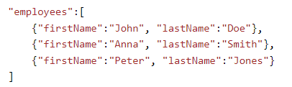
JSON OBJECTS
JSON objects are written inside curly braces.
JSON arrays are written inside square brackets.

Slide 16
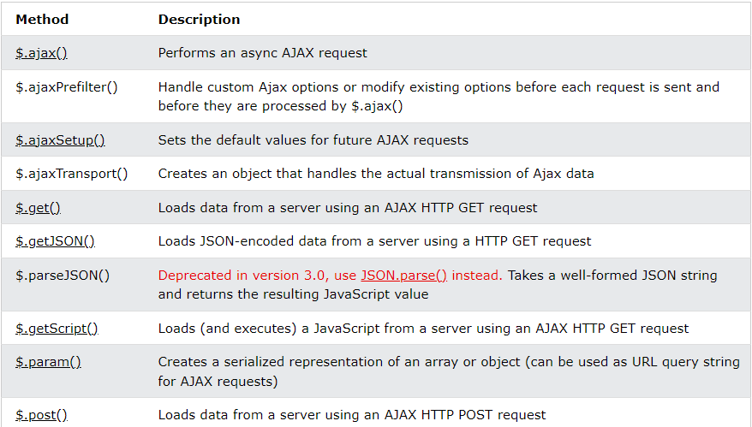
JQUERY – AJAX METHODS

Slide 17
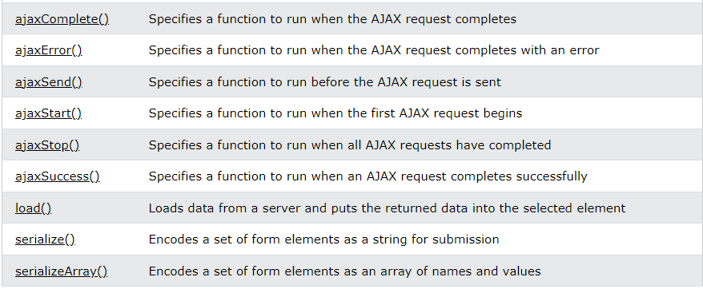
JQUERY – AJAX METHODS

Slide 18
JQUERY – AJAX LOAD() METHOD
The load() method loads data from a server and puts the returned data into the selected element.
Syntax:
  $(selector).load(URL,data,callback);
URL = parameter specifies the URL you wish to load.
data = optional parameter specifies a set of query string key/value pairs to send along with the request.
callback = parameter is the name of a function to be executed after the load() method is completed.

Slide 19
JQUERY – AJAX LOAD() METHOD
function emailFormat(){
let email = $('#email').val();
let re = /^\w+([-+.'][^\s]\w+)*@\w+([-.]\w+)*\.\w+([-.]\w+)*$/;
var emailFormat = re.test(email); // This return result in Boolean type
if (!emailFormat) {
$('#email').css("border", "1px solid red");
$('#erroremail').html("Email is invalid");
}else{
$('#email').css("border", "1px solid black");
$('#erroremail').html("");
}
}

Slide 20
JQUERY – AJAX LOAD() METHOD
Here is the content of our example file: "demo_test.txt":
<h2>jQuery and AJAX is FUN!!!</h2>
<p id="p1">This is some text in a paragraph.</p>
$("#div1").load("demo_test.txt");
$("#div1").load("demo_test.txt #p1");

Slide 21
JQUERY – AJAX LOAD() METHOD
callback parameter specifies a callback function to run when the load() method is completed. The callback function can have different parameters:
  responseTxt - contains the resulting content if the call succeeds
  statusTxt - contains the status of the call
  xhr - contains the XMLHttpRequest object

Slide 22
JQUERY – AJAX LOAD() METHOD
Example:
$("button").click(function(){
$("#div1").load("demo_test.txt", function(responseTxt, statusTxt, xhr){
if(statusTxt == "success")
alert("External content loaded successfully!");
if(statusTxt == "error")
alert("Error: " + xhr.status + ": " + xhr.statusText);
});
});

Slide 23
JQUERY – AJAX GET() AND POST() METHOD
HTTP Request: GET vs. POST
GET - Requests data from a specified resource
POST - Submits data to be processed to a specified resource
GET is basically used for just getting (retrieving) some data from the server. Note: The GET method may return cached data.
POST can also be used to get some data from the server. However, the POST method NEVER caches data, and is often used to send data along with the request.

Slide 24
JQUERY – AJAX $.GET() METHOD
$.get() method requests data from the server with an HTTP GET request.
Syntax: $.get(URL,callback);
URL : required parameter specifies the URL you wish to request.
Callback : optional parameter is the name of a function to be executed if the request succeeds.

Slide 25
JQUERY – AJAX $.GET() METHOD
Example:
$("button").click(function(){
$.get("demo_test.php", function(data, status){
alert("Data: " + data + "\nStatus: " + status);
});
});
The first parameter of $.get() is the URL we wish to request ("demo_test.asp").
The second parameter is a callback function. The first callback parameter holds the content of the page requested, and the second callback parameter holds the status of the request.

Slide 26
JQUERY – AJAX $.POST() METHOD
$.post() method requests data from the server using an HTTP POST request
Syntax:
$.post(URL,data,callback);
URL : parameter specifies the URL you wish to request.
Data : optional parameter specifies some data to send along with the request.
Callback : optional parameter is the name of a function to be executed if the request succeeds.

Slide 27
JQUERY – AJAX $.POST() METHOD
Example:
$("button").click(function(){
$.post("demo_test_post.php",
{
name: "Donald Duck",
city: "Duckburg"
},
function(data, status){
alert("Data: " + data + "\nStatus: " + status);
});
});

Slide 28
THANK YOU

